Slide 1
Data Flow Diagrams
Session 10
(Tutorial)
Course : Program Design Methods
Effective Period : July 2018

Slide 2
These slides have been adapted from
Systems Analysis & Design, Alan Dennis, Barbara Haley Wixom, Roberta M.Roth, Fifth Edition,
Course Technology. ISBN: 13 978-0-470.22854-8. Chapter 5
Acknowledgement

Slide 3
LO 4 : Demonstrate the use of program design method
Learning Objectives

Slide 4
Contents
Introduction Data Flow Diagrams
Reading Data Flow Diagrams
Elements of Data Flow Diagrams
Using Data Flow Diagrams to Define Business Processes
Process Descriptions
Introduction Crating Data Flow Diagrams
Creating the Context Diagram
Creating Data Flow Diagram Fragments
Creating the Level 0 data Flow Diagram
Creating the Level 1 Data Flow Diagram
Validating the Data Flow Diagram

Slide 5
Reading Data Flow Diagrams

Slide 6
Introduction DFD
Data Flow Diagram (DFD) is a technique that diagrams the business processes and the data that pass among them
The DFD is a conceptual model – it doesn’t represent the computer program, it represents what the program must accomplish.
By showing the input and output of each major task, it shows how data must move through and be transformed by the program.

Slide 7
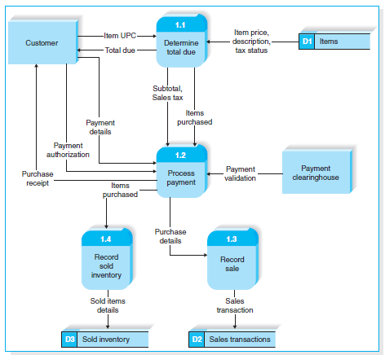
Reading Data Flow Diagram
DFD for the process of buying goods at the supermarket

Slide 8
Reading Data Flow Diagram
By examining the DFD, an analyst can understand the process by which customers checkout at the supermarket.

Slide 9
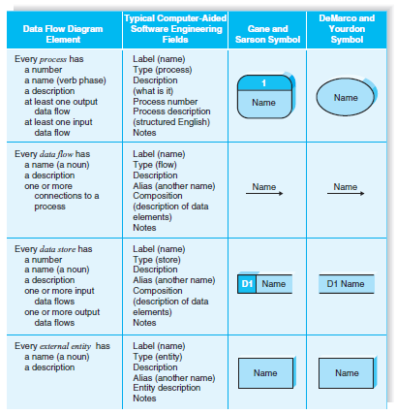
Elements Data Flow Diagram

Slide 10
Reading Data Flow Diagram
Process
Process is an activity or a function that is performed for some specific business reason
Every process should be named starting with a verb and ending with a noun (e.g., “Determine total due”)
Process must have at least one input data flow and at least one output data flow

Slide 11
Reading Data Flow Diagram
Data Flow
Data flow is a single piece of data (e.g., item UPC), or a logical collection of several pieces of information (e.g., purchase receipt)
Every data flow should be named with a noun

Slide 12
Reading Data Flow Diagram
Data Store
Data store is a collection of data that is stored in some way (which is determined later when creating the physical model)
Every data store is named with a noun and is assigned an identification number and a description.

Slide 13
Reading Data Flow Diagram
External Entity
External entity is a person, organization, or system that is external to the system, but interacts with it (e.g., sustemer, clearinghouse, government organization, accounting system)
External entities provide data to the system or receive data from the system, and serve to establish the system boundaries

Slide 14
Using Data Flow Diagram to Define Business Processes
Most business processes are too complex to be explained in one DFD.
Most process models are therefore composed of a set of DFDs.
The first DFD provides a summary of the overall system, with additional DFDs providing more and more detail about each part of the overall business process.
Thus, one important principle in process modeling with DFDs is the decomposition of the business process into a series of DFDs, each representing a lower level detail.

Slide 15
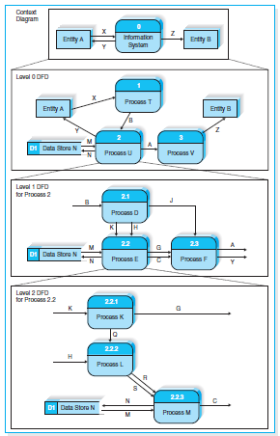
Using Data Flow Diagram to Define Business Processes

Slide 16
Using Data Flow Diagram to Define Business Processes
Context Diagram
The first DFD in every business process model, whether a manual system or a computerized system, is the context diagram.
The context diagram shows the entire system in the context with its environment.
All process models have one context diagram
The context diagram shows the overall business process as just one process (i.e., the system itself) and shows the data flows to and from external entities

Slide 17
Using Data Flow Diagram to Define Business Processes
Level 0 Diagram (Level 0 DFD)
Level 0 diagram shows all the processes at the first level of numbering(i.e., processes numbered 1 through 3), the data stores, external entities, and data lows among them.
The purpose of the level 0 DFD is to show all the major high-level processes of the system and how they are interrelated
All process models have one and only one level 0 DFD
Another key priciple in creating sets of DFDs is balancing
Balancing means ensuring that all information presented in a DFD at one level is accurately represented in the next-level DFD

Slide 18
Using Data Flow Diagram to Define Business Processes
Level 1 Diagram (Level 1 DFD)
Each process on the level 0 DFD can be decomposed into more explicit DFD, called level 1 diagram or level 1 DFD, which shows how it operates in greater detail.
In general, all process models have as many level 1 diagram as there are processes on the level 0 diagram; every process in the level 0 DFD would be decomposed into its own level 1 DFD.
The process in level 1 DFD are numbered on the basis of the process being decomposed.
For example, if we are decomposing process 2, and there are three level 1 DFD, so the process in this level 1 DFD are numbered 2.1, 2.2 and 2.3

Slide 19
Using Data Flow Diagram to Define Business Processes
Level 2 Diagram (Level 2 DFD)
Each process on the level 1 DFD can be decomposed into more explicit DFD, called level 2 diagram or level 2 DFD, which shows how it operates in greater detail.
In general, all process models have as many level 2 diagram as there are processes on the level 1 diagram; every process in the level 1 DFD would be decomposed into its own level 2 DFD.
The process in level 2 DFD are numbered on the basis of the process being decomposed.
For example, if we are decomposing process 2.2, and there are three level 2 DFD, so the process in this level 2 DFD are numbered 2.2.1, 2.2.2 and 2.2.3

Slide 20
Process Descriptions
The purpose of the process description is to explain what the process does and provide additional information that the DFD does not provide.
Three techniques are commonly used to describe processing logic : structured English, decision trees, and decision tables.
Structured English uses short sentences to describe the work that a process performs.
Decision trees display decision logic (IF statements) as a set of nodes (questions) and branches (answer).
Decision tables represent complex policy decisions as rules that link various conditions with actions.

Slide 21
Introduction Creating DFD
Data flow diagrams start with the information in the use cases and the requirements definition.
The DFDs typically are created by the project team and reviewed by the users.
Project teams usually use process modeling tools or CASE tools to draw process models.
Simple tools such as Visio are just fancy drawing tools that work like PowerPoint in that they do not understand the syntax or the meaing of DFD elements

Slide 22
Introduction
Other process modeling tools such as BPWin understand the DFD and can perform simple syntax checking to make sure that the DFD is at least somewhat correct.
A full CASE tool, such as Visible Analyst Workbench, provides many capabilities in addition to process modeling.
CASE tools tend to be complex, and while they are valuable for large and complex projects, they often cost more than they add for simple projects.

Slide 23
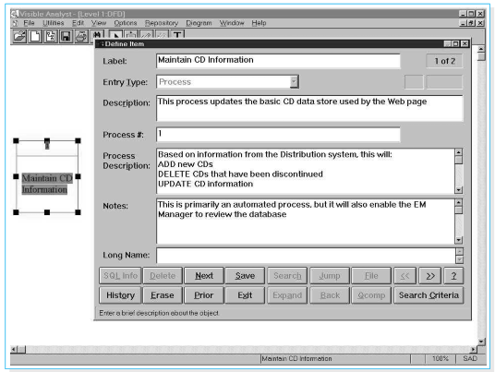
Entering Data Flow Diagram Process in Visible Analyst CASE Tool

Slide 24
Creating the Context Diagram
The context diagram defines how the business process or computer system interacts with its environment – primarily the external entities.
Usually, all inputs and outputs will come from or go to external entities such as a person, organization, or other information system.
If any inputs and outputs connect directly to data stores in an external system, it is best practice to create an external entity which is named for the system that owns the data store.

Slide 25
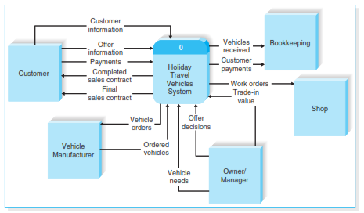
The context Diagram for ther Holiday Travel Vechicles syatem

Slide 26
Creating Data Flow Diagram Fragments
A DFD fragments is one part of a DFD that eventually will be combined with other DFD fragments to form a DFD.
In this step, each use case is converted into one DFD fragment.
Start by taking each use case and drawing a DFD fragment, using the information given on the top of the use case: the name, ID number, and major inputs and outputs

Slide 27
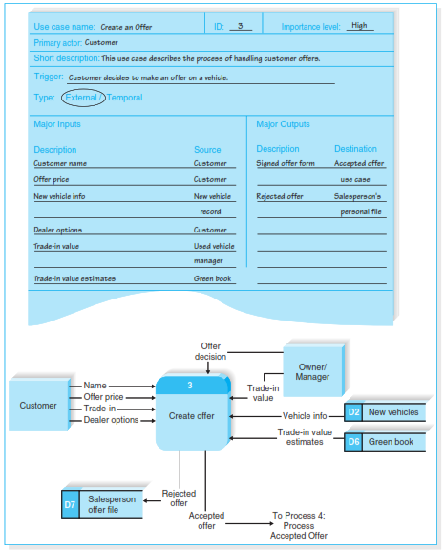
Holiday Travel Vehicles Process 3 DFD Fragment

Slide 28
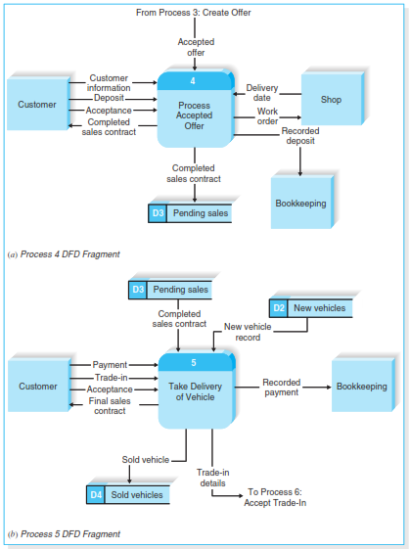
Holiday Travel Vehicles Process 3 DFD Fragment

Slide 29
Creating the Level 0 Data Flow Diagram
Once you have the set of DFD fragments, you simply combine them into one DFD drawing that becomes the level 0 DFD.
There are no formal layout rules for DFD, however, most systems analysts try to put the process that is first chronologically in the upper left corner of the diagram and work their way from top to bottom, left to right

Slide 30
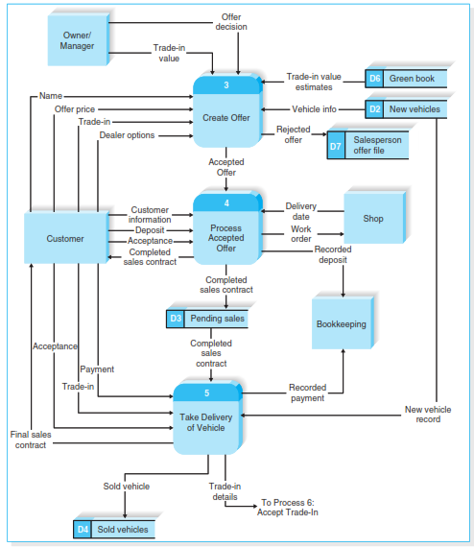
Holiday Travel Vehicles Partial Level 0 DFD

Slide 31
Creating the Level 1 Data Flow Diagram
The team now begins to create lower-level DFDs for each process in the level 0 DFD that needs a level 1 DFD.
The process for creating the level 1 DFDs is to take the steps as written on the use cases and convert them into a DFD in much the same way as for the level 0 DFD.
Usually, each step in the use case becomes a process on the level 1 DFD, with the inputs and outputs becoming the input and output data flows.

Slide 32
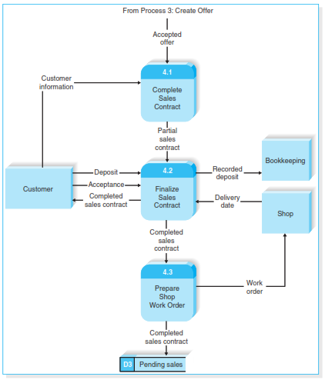
Level 1 DFD for Process Acepted Offer

Slide 33
Validating the Data Flow Diagrams
Once you have created a set of DFDs, it is important to check them for quality.
There are two fundamentally different types of problems that can occur in DFDs : syntax errors and semantics errors.
Syntax refers to the structure of the DFDs and whether the DFDs follow the rules of the DFD languages.
Semantics refers to the meaning of the DFDs and whether the accurately describe the business process being modeled

Slide 34
References
SystemsAnalysis and Design, Dennis, Allan Cs (2015), Fifth Edition, ISBN : 13 978-0-470.22854-8.
What is a Data Flow Diagram, https://www.lucidchart.com/pages/data-flow-diagram
Data Flow Diagram Symbols, Types, and Types, https://www.lucidchart.com/blog/data-flow-diagram-tutorial

Slide 35
Q & A

